Slide 1
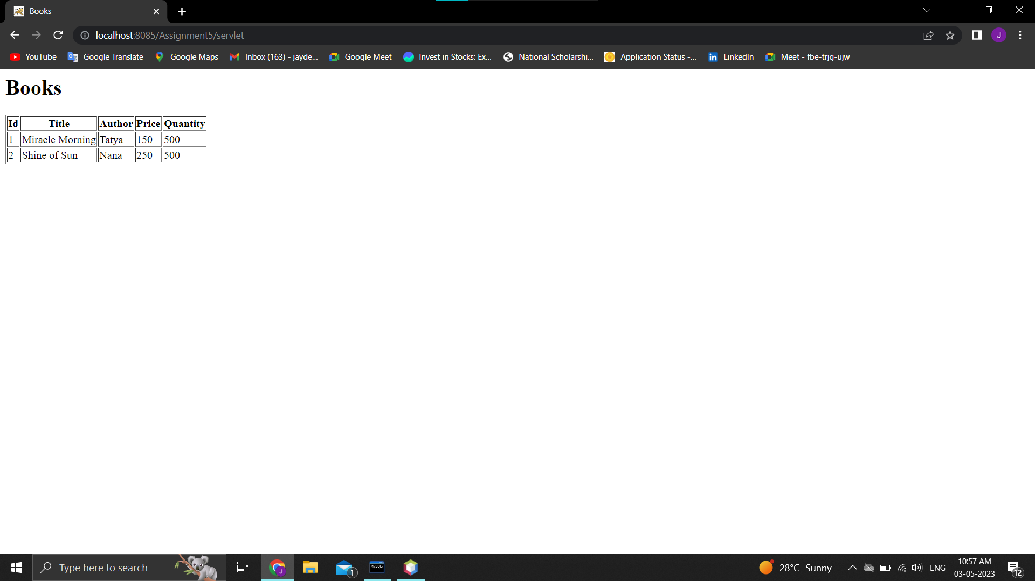
Assignment 5 Output:-

